Slide 1
Programación de dispositivos móviles
Einar David Villarroel Vargas

Slide 2
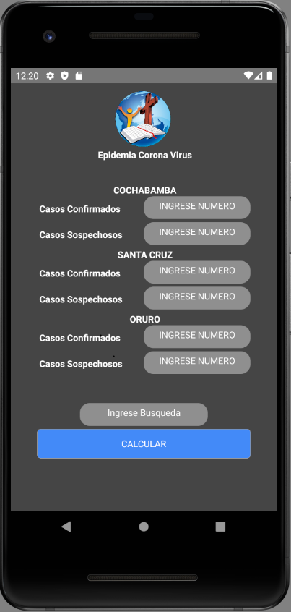
Diseñar e implementar el componente CVLogo.
import React, { Component } from 'react';
import {StyleSheet, View, Text, Image } from 'react-native';
import imgLogo from '../images/Logo.png';
export default class Logo extends Component {
constructor(props) {
console.log(props.text);
super(props);
} render() {
return (
<View style={styles.container}>
<Image source={imgLogo} style={styles.image}></Image>
<Text style={styles.text}> Epidemia Corona Virus</Text>
</View>
);
}
}
const styles = StyleSheet.create({
container:{
flex:1,
alignItems: 'center',
//justifyContent: 'center',
},
image:{
width:120,
height:120,
},
text:{
color:'white',
fontWeight:'bold',
backgroundColor:'transparent',
marginTop:-20,
},
});

Slide 3
Diseñar e implementar el componente CVCasos.
import React, { Component } from 'react';
import { StyleSheet, View, Text, TextInput } from 'react-native';
import PropTypes from 'prop-types';
import Colors from '../Config/Colors';
export default class TextInputForm extends Component {
constructor(props) {
super(props);}
render() {
return (
<View style={stylesTextInput.Contenido}> <Text style={stylesTextInput.text}> {this.props.contenido} </Text> <View style={stylesTextInput.ContText}>
<TextInput
onChangeText={this.props.onChangeText}
style={stylesTextInput.textInput}
placeholder={this.props.placeholder}
secureTextEntry={this.props.secureTextEntry}
autoCorrect={this.props.autoCorrect}
placeholderTextColor={Colors.white}
underlineColorAndroid="transparent"
/>
</View> </View> );
}
}
TextInputForm.PropTypes = {
source: PropTypes.number.isRequired,
placeholder: PropTypes.string.isRequired,
autoCorrect: PropTypes.bool,
secureTextEntry: PropTypes.bool,
};
const stylesTextInput = StyleSheet.create({
Contenido:{
width: '100%‘,
},
ContText: {
width: '50%',
alignSelf: 'flex-end',
marginBottom: 5,
},
textInput: {
backgroundColor: 'rgba(255, 255, 255, 0.4)',
borderColor: Colors.silver,
textAlign: 'center',
borderRadius: 15,
height:35,
},
text: {
color: 'white',
fontWeight: 'bold',
backgroundColor: 'transparent',
alignSelf: 'flex-start',
width: '48%',
position: 'absolute',
top:9,
},
});

Slide 4
Diseñar e implementar el componente CVCiudad.
import React, { Component } from 'react';
import { StyleSheet, View, Text, Image, TextInput } from 'react-native';
import PropTypes from 'prop-types';
import Colors from '../Config/Colors';
import CVCasos from '../Componentes/CVCasos';
import Constans from '../Config/Constans';
export default class TextForm extends Component {
constructor(props) {
super(props);
}
render() {
return (
<View style={stylesTextInput.Cont}>
<Text style={stylesTextInput.text}> {this.props.titulo}</Text> <CVCasos contenido={this.props.contenido}
onChangeText={this.props.O1}
placeholder={Constans.NUMERO}
secureTextEntry={false}
autoCorrect={false}>
</CVCasos>
<CVCasos
contenido={this.props.contenido2}
onChangeText={this.props.O2}
placeholder={Constans.NUMERO}
secureTextEntry={false}
autoCorrect={false}>
</CVCasos> </View>
);
}
}
TextForm.PropTypes = {
source: PropTypes.number.isRequired,
placeholder: PropTypes.string.isRequired,
autoCorrect: PropTypes.bool,
secureTextEntry: PropTypes.bool,
};
const stylesTextInput = StyleSheet.create({
Cont: {
//marginTop: -500,
},
text: {
color: 'white',
fontWeight: 'bold',
backgroundColor: 'transparent',
//marginTop: -200,
textAlign: 'center',
},
});

Slide 5
Diseñar e implementar el componente CVscreen.
import React, { Component } from 'react';
import { StyleSheet, View, TextInput } from 'react-native';
import ButtonC from '../Componentes/Button';
import CVCiudad from '../Componentes/CVCiudad';
import CVLogo from '../Componentes/CVLogo';
//import CVTEXT from '../Componentes/CVCasos';
import Constans from '../Config/Constans';
import Colors from '../Config/Colors';
export default class CVScreen extends Component {
constructor(props) {
super(props);
this.state = {
CBBACC: 0,
CBBACS: 0,
SCCC: 0,
SCCS: 0,
ORCC: 0,
ORCS: 0,
RES: '',
};
this._onPress = this._onPress.bind(this);
this._onChangeCBBACC = this._onChangeCBBACC.bind(this);
this._onChangeCBBACS = this._onChangeCBBACS.bind(this);
this._onChangeSCCC = this._onChangeSCCC.bind(this);
this._onChangeSCCS = this._onChangeSCCS.bind(this);
this._onChangeORCC = this._onChangeORCC.bind(this);
this._onChangeORCS = this._onChangeORCS.bind(this);
this._onPressCon = this._onPressCon.bind(this);
}
_onPress() {
console.log('button preset..!!!');
let C, S, O;
if (this.state.RES === "C") {
C = this.state.CBBACC;
S = this.state.SCCC;
O = this.state.ORCC;
}
else if (this.state.RES === "S") {
C = this.state.CBBACS;
S = this.state.SCCS;
O = this.state.ORCS;
}
else {
console.log('Ingrese C o S')
}
let R = Math.max(C, S, O);
console.log('El mayor es: ' + R); }
_onPressCon(RES) {
this.setState({ RES: RES })
}
_onChangeCBBACC(CBBACC) {
this.setState({ CBBACC: CBBACC })
}
_onChangeCBBACS(CBBACS) {
this.setState({ CBBACS: CBBACS })
}
_onChangeSCCC(SCCC) {
this.setState({ SCCC: SCCC })
}
_onChangeSCCS(SCCS) {
this.setState({ SCCS: SCCS })
}
_onChangeORCC(ORCC) {
this.setState({ ORCC: ORCC })
}
_onChangeORCS(ORCS) {
this.setState({ ORCS: ORCS })
}

Slide 6
Diseñar e implementar el componente CVscreen.
render() {
return (
<View style={stylesLoginScreen.container}>
<CVLogo style={stylesLoginScreen.logo} />
<View style={stylesLoginScreen.form}>
<CVCiudad
titulo={Constans.CBBA}
contenido={Constans.CC}
O1={this._onChangeCBBACC}
placeholder={Constans.NUMERO}
secureTextEntry={false}
autoCorrect={false}
contenido2={Constans.CS}
O2={this._onChangeCBBACS}
>
</CVCiudad>
<CVCiudad
titulo={Constans.SC}
contenido={Constans.CC}
//onChangeText={this._onChangeTextUsername}
O1={this._onChangeSCCC}
placeholder={Constans.NUMERO}
secureTextEntry={false}
autoCorrect={false}
contenido2={Constans.CS}
O2={this._onChangeSCCS}
>
</CVCiudad>
<CVCiudad
titulo={Constans.OR}
contenido={Constans.CC}
//onChangeText={this._onChangeTextUsername}
O1={this._onChangeORCC}
placeholder={Constans.NUMERO}
secureTextEntry={false}
autoCorrect={false}
contenido2={Constans.CS}
O2={this._onChangeORCS}
>
</CVCiudad>
<TextInput
style={stylesLoginScreen.Bus}
placeholder={Constans.BUS}
secureTextEntry={false}
autoCorrect={false}
onChangeText={this._onPressCon}
placeholderTextColor={Colors.white}
underlineColorAndroid="transparent"
/>
<ButtonC
onPress={this._onPress}
titleButton={Constans.TITLE_BUTTON}>
</ButtonC>
</View>
</View>
);
}
}
const stylesLoginScreen = StyleSheet.create({
container: {
flex: 1,
backgroundColor: Colors.dark,
alignItems: 'center',
justifyContent: 'space-between',
},
logo: {
flex: 1,
width: '100%',
resizeMode: 'contain',
alignSelf: 'center',
},
form: {
marginTop: -350,
flex: 1,
//justifyContent: 'center',
width: '80%',
},
Bus: {
width: '60%',
backgroundColor: 'rgba(255, 255, 255, 0.4)',
borderColor: Colors.silver,
textAlign: 'center',
borderRadius: 15,
height: 35,
marginBottom: 5,
alignSelf: 'center',
marginTop: 40,
},
});

Slide 7
Generar la clase App.JS.
import React from 'react';
import CVScreen from './src/View/CVScreen';
const App: () => React$Node = () => {
return (
<CVScreen></CVScreen>
);
};
export default App;

Slide 8
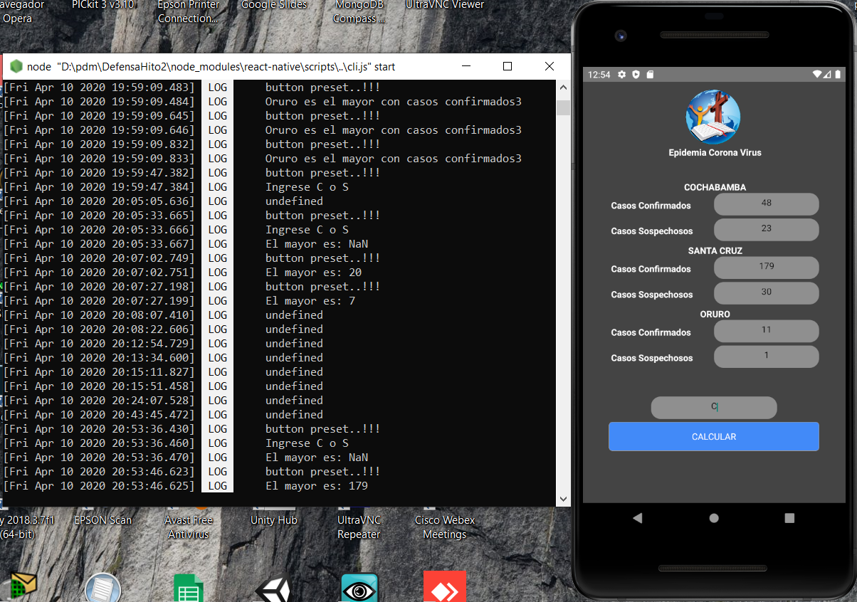
Compilación del código

Slide 9
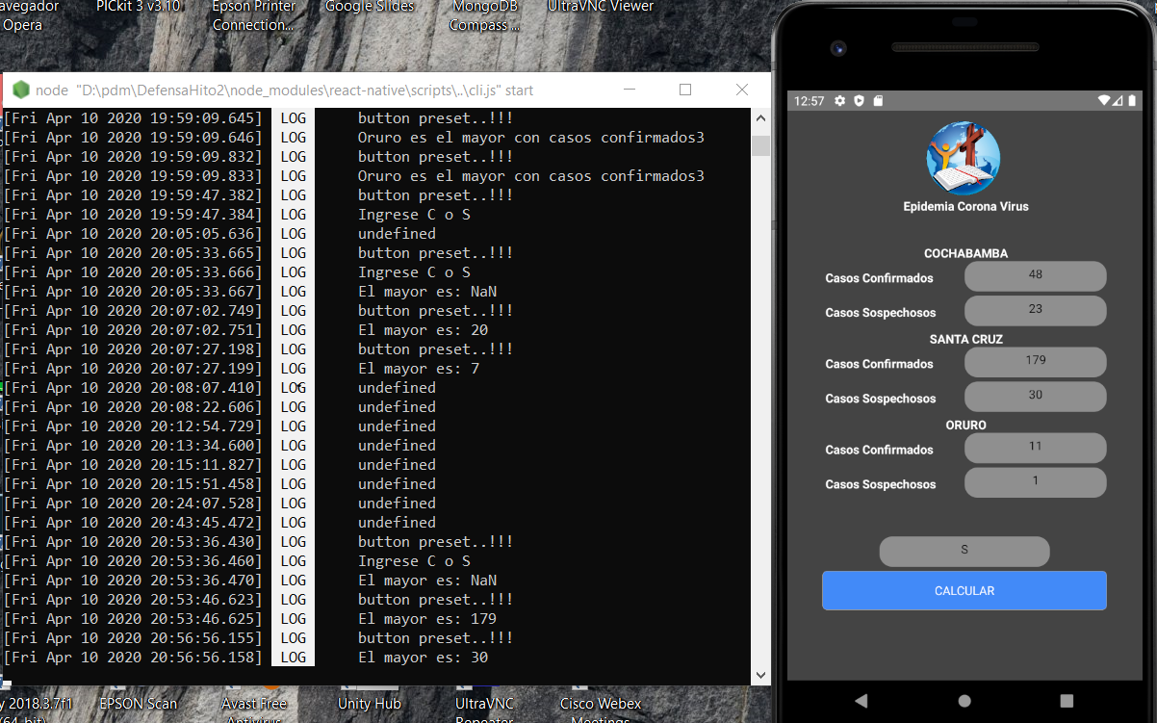
Compilación del código

